Slide 1


EARTHQUAKE PREDICTION MODEL USING PYHTON
TEAM:
ASHMI W SHARON
ASHMA S B
ASLIN SELJA V
ASHLIN JESHMA J S
CHRISTALIN SHEMY C

Slide 2
PROBLEM STATEMENT
Data Collection: Gather historical earthquake data, including information on the date, time, location, magnitude, depth, and any relevant environmental factors (e.g., tectonic plate boundaries, fault lines, geological features, weather conditions, etc.).
Data Preprocessing: Clean and preprocess the collected data, including handling missing values, outliers, and converting data into a suitable format for model training.
Feature Engineering: Extract or create relevant features from the data, such as distance from fault lines, historical seismic activity in the region, and other geospatial and environmental factors.
Model Selection: Choose an appropriate machine learning algorithm (e.g., regression, classification, time series forecasting) to build the earthquake prediction model. Consider methods such as logistic regression, support vector machines, random forests, neural networks, or time series models.
Model Training: Split the data into training and testing sets and train the selected model on the historical earthquake data. Fine-tune hyperparameters to optimize model performance.
Evaluation: Evaluate the model's performance using appropriate metrics, such as accuracy, precision, recall, F1-score, or RMSE (Root Mean Square Error) for regression models.

Slide 3
PROBLEM STATEMENT
Deployment: Create a user-friendly interface or application that can provide real-time or periodic earthquake predictions to stakeholders or the public.
Continuous Monitoring: Implement mechanisms to continuously update the model with new data and retrain it to adapt to changing seismic patterns.
Early Warning System: Develop a system that triggers alerts or warnings when the model predicts a high probability of an earthquake occurrence, helping authorities and the public to take precautionary measures.
Documentation: Provide clear documentation for the model, including how to interpret its predictions, limitations, and potential false positives/negatives.
Ethical Considerations: Address ethical concerns related to data privacy, misinformation, and the potential impact of false predictions.
Scalability: Design the system to handle increased data volume and ensure it can be applied to different regions prone to earthquakes.

Slide 4





LIBRARIES USED
NumPy
TensorFlow
Scikit-learn
Pandas
Matplotlib

Slide 5
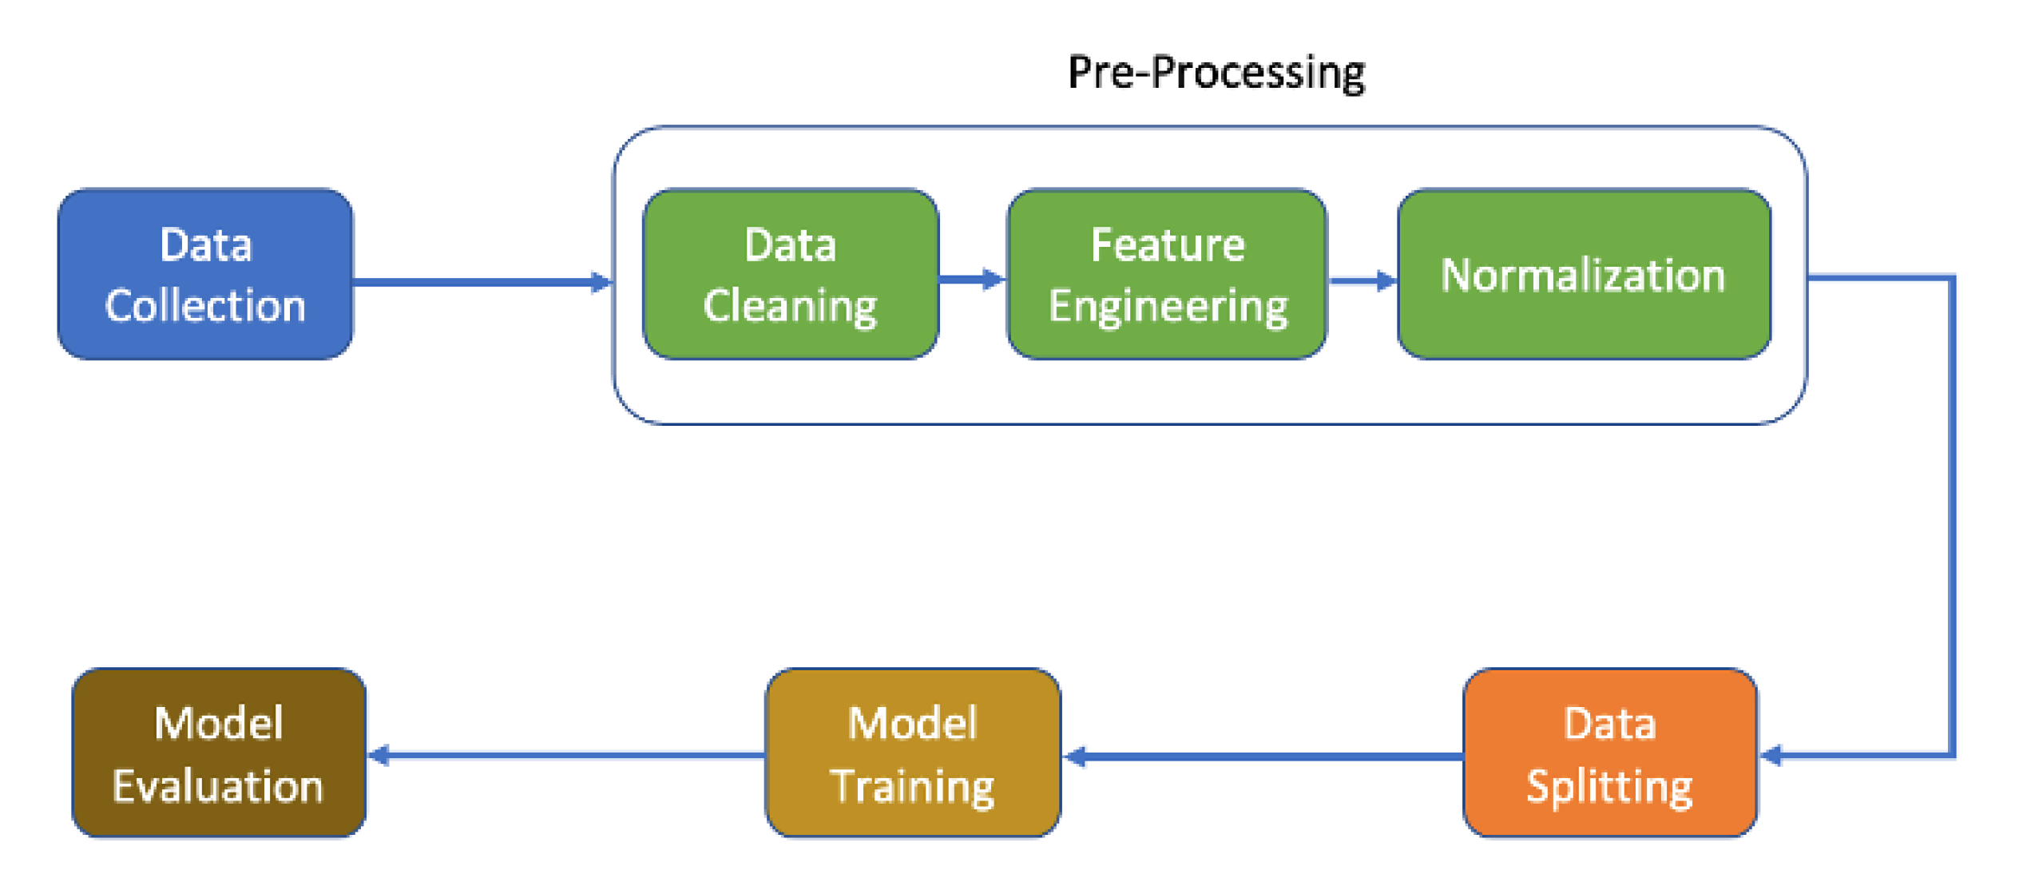
OVERALL DESIGN

Slide 6
ARCHITECTURE FOR EARTHQUAKE PRECTION MODEL
Data Collection:
Obtain historical earthquake data from sources like the United States Geological Survey (USGS) or other relevant geological organizations.
Collect additional data, such as the earthquake's depth, latitude, and longitude, which may be used as features.
Data Preprocessing:
Clean and preprocess the data to handle missing values, outliers, and inconsistencies.
Feature engineering: Extract relevant features such as the time of day, season, and geographical features based on latitude and longitude.
Data Splitting:
Split the data into a training set and a test set to evaluate model performance.
Machine Learning Model:
Choose a machine learning model, such as a regression model, to predict earthquake magnitudes based on the selected features.
Train the model on the training data.
Model Evaluation:
Evaluate the model's performance on the test data using metrics like Mean Squared Error (MSE) or R-squared (R2) to assess the accuracy of magnitude predictions.
Model Deployment:
If the model performs well, you can deploy it in a production environment where it can take input features (e.g., depth, latitude, longitude) and provide magnitude predictions.

Slide 7
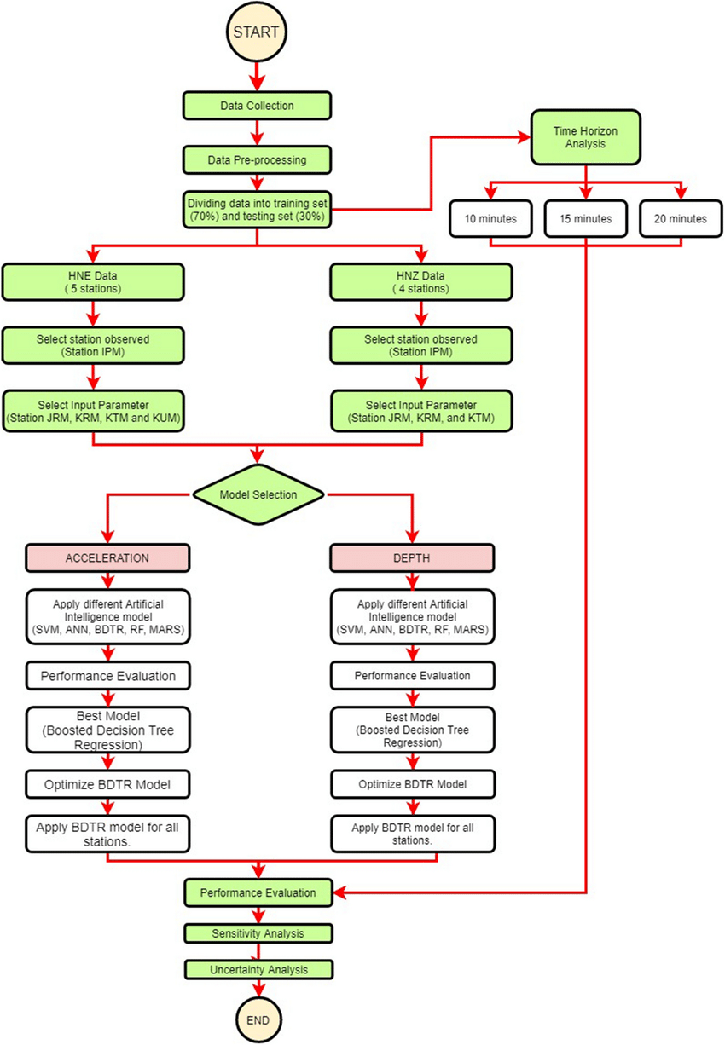
FLOW CHART FOR EARTHQUAKE PREDICTION

Slide 8
CODING
# Import necessary libraries
import numpy as np
import pandas as pd
from sklearn.model_selection import train_test_split
from sklearn.linear_model import LinearRegression
from sklearn.metrics import mean_squared_error, r2_score
# Load earthquake data (you need a dataset for this)
# You can find earthquake datasets from sources like USGS.
# Assuming your dataset has features like magnitude, depth, latitude, and longitude
# and the target variable is magnitude.
# Load your data into a pandas DataFrame
data = pd.read_csv("earthquake_data.csv")

Slide 9
# Split data into features (X) and target variable (y)
X = data[['depth', 'latitude', 'longitude']]
y = data['magnitude']
# Split the data into training and testing sets
X_train, X_test, y_train, y_test = train_test_split(X, y, test_size=0.2, random_state=42)
# Create a linear regression model
model = LinearRegression()
# Train the model on the training data
model.fit(X_train, y_train)
# Make predictions on the test data
y_pred = model.predict(X_test)
# Evaluate the model
mse = mean_squared_error(y_test, y_pred)
r2 = r2_score(y_test, y_pred)
print("Mean Squared Error:", mse)
print("R-squared:", r2)

Slide 10
IMPORTING LIBARIES
import numpy as np
import pandas as pd
import matplotlib.pyplot as plt
import os
print(os.listdir("../input"))
OUTPUT
[‘database.csv’]

Slide 11
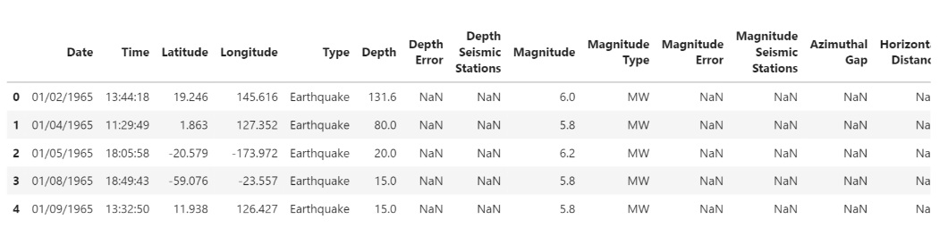
READ THE DATASET
Now we will read the dataset and look for the various features in the dataset
data = pd.read_csv("../input/database.csv")
data.head()
OUTPUT

Slide 12
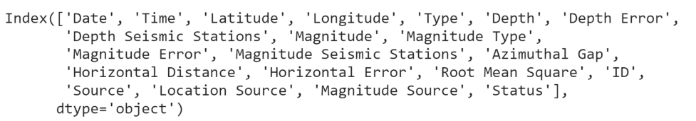
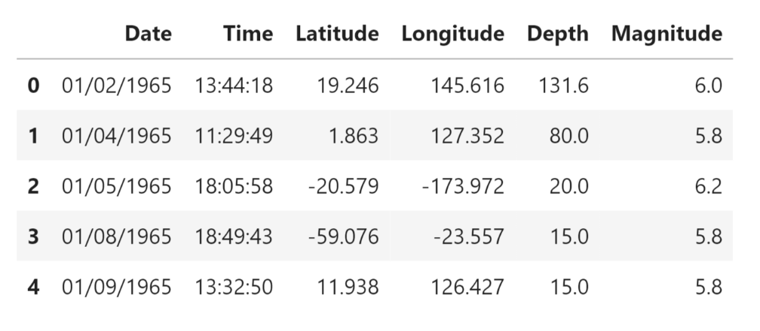
data.columns
Output:
We need to select the features that will be useful for our prediction.
data = data[['Date', 'Time', 'Latitude', 'Longitude', 'Depth', 'Magnitude']]
data.head()
Output:

Slide 13
We will try to frame the time and place of the earthquake that has happened in the past on the world map.
import datetime
import time
timestamp = []
for d, t in zip(data['Date'], data['Time']):
try:
ts = datetime.datetime.strptime(d+' '+t, '%m/%d/%Y %H:%M:%S')
timestamp.append(time.mktime(ts.timetuple()))
except ValueError:
# print('ValueError’)
timestamp.append('ValueError')
timeStamp = pd.Series(timestamp)
data['Timestamp'] = timeStamp.values

Slide 14
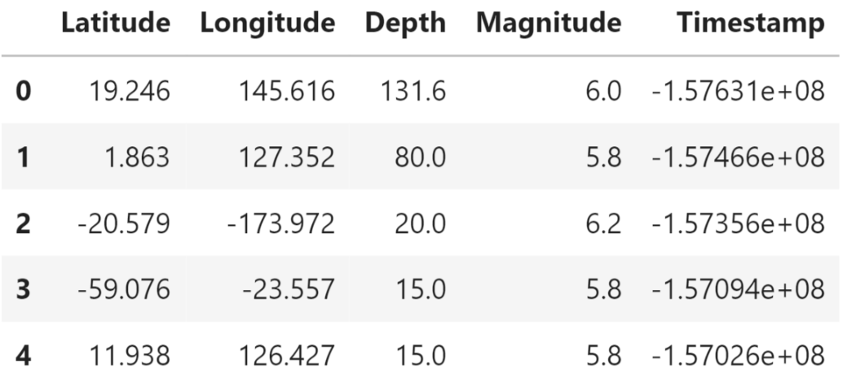
final_data = data.drop(['Date', 'Time'], axis=1)
final_data = final_data[final_data.Timestamp != 'ValueError']
final_data.head()
Output:

Slide 15
Visualization
Here, we will visualize the earthquakes that have occurred all around the world.
from mpl_toolkits.basemap import Basemap
m = Basemap(projection='mill',llcrnrlat=-80,urcrnrlat=80, llcrnrlon=
180,urcrnrlon=180,lat_ts=20,resolution='c')
longitudes = data["Longitude"].tolist()
latitudes = data["Latitude"].tolist()
#m = Basemap(width=12000000,height=9000000,projection='lcc’,
#resolution=None,lat_1=80.,lat_2=55,lat_0=80,lon_0=-107.)
x,y = m(longitudes,latitudes)

Slide 16
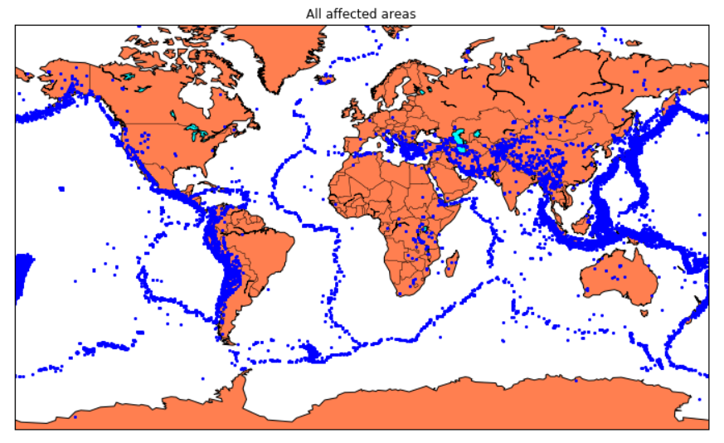
fig = plt.figure(figsize=(12,10))
plt.title("All affected areas")
m.plot(x, y, "o", markersize = 2, color = 'blue')
m.drawcoastlines()
m.fillcontinents(color='coral',lake_color='aqua')
m.drawmapboundary()
m.drawcountries()
plt.show()
Output:

Slide 17
Splitting The Dataset
Now we will split the dataset into a training and testing set.
X = final_data[['Timestamp', 'Latitude', 'Longitude']]
y = final_data[['Magnitude', 'Depth']]
from sklearn.cross_validation import train_test_split
X_train, X_test, y_train, y_test = train_test_split(X, y, test_size=0.2, random_state=42)
print(X_train.shape, X_test.shape, y_train.shape, X_test.shape)
Output:

Slide 18
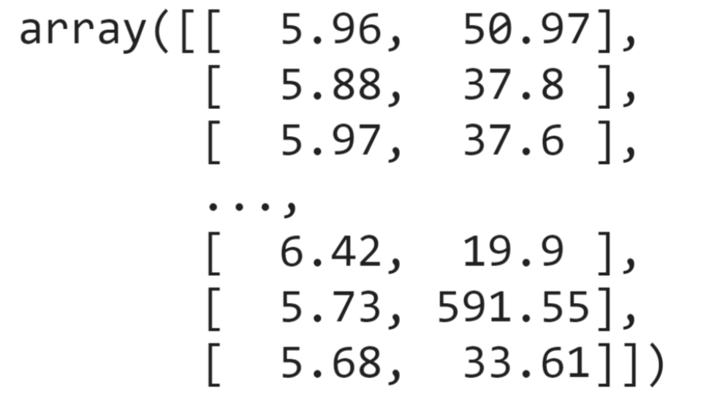
We will be using the RandomForestRegressor model to predict the earthquake, here will look for its accuracy.
reg = RandomForestRegressor(random_state=42)
reg.fit(X_train, y_train)
reg.predict(X_test)
Output:

Slide 19

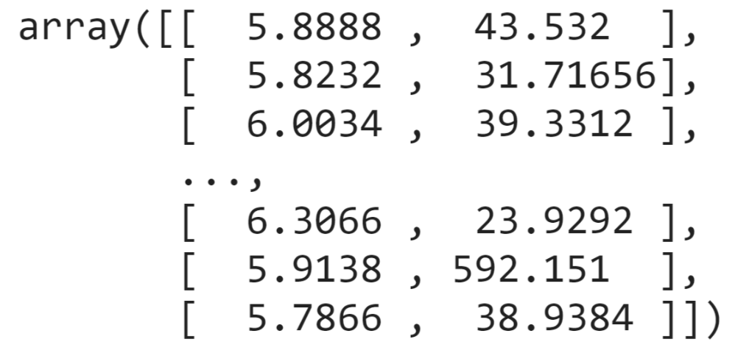
reg.score(X_test, y_test)
Output:
86% of accuracy is quite high.
Now we will shift to GridSearch.
from sklearn.model_selection import GridSearchCV
parameters = {'n_estimators':[10, 20, 50, 100, 200, 500]}
grid_obj = GridSearchCV(reg, parameters)
grid_fit = grid_obj.fit(X_train, y_train)
best_fit = grid_fit.best_estimator_
best_fit.predict(X_test)
Output:

Slide 20
Neural Network Model
A neural network model can be employed to forecast earthquakes by examining diverse elements and trends in seismic data. This model harnesses the capabilities of neural networks, which draw inspiration from the neural connections of the human brain, to analyze intricate data and reveal hidden relationships and patterns. By training the neural network on historical earthquake data, it can acquire the ability to identify precursor signals and patterns that indicate the probability of an upcoming earthquake.
from keras.models import Sequential
from keras.layers import Dense
def create_model(neurons, activation, optimizer, loss):
model = Sequential()
model.add(Dense(neurons, activation=activation, input_shape=(3,)))
model.add(Dense(neurons, activation=activation))
model.add(Dense(2, activation='softmax'))
model.compile(optimizer=optimizer, loss=loss, metrics=['accuracy'])
return model

Slide 21
from keras.wrappers.scikit_learn import KerasClassifier
model = KerasClassifier(build_fn=create_model, verbose=0)
# neurons = [16, 64, 128, 256]
neurons = [16]
# batch_size = [10, 20, 50, 100]
batch_size = [10]
epochs = [10]
# activation = ['relu', 'tanh', 'sigmoid', 'hard_sigmoid', 'linear', 'exponential']
activation = ['sigmoid', 'relu']
# optimizer = ['SGD', 'RMSprop', 'Adagrad', 'Adadelta', 'Adam', 'Adamax', 'Nadam']
optimizer = ['SGD', 'Adadelta']
loss = ['squared_hinge']
param_grid = dict(neurons=neurons, batch_size=batch_size, epochs=epochs, activation=activation, optimizer=optimizer, loss=loss)
grid = GridSearchCV(estimator=model, param_grid=param_grid, n_jobs=-1)
grid_result = grid.fit(X_train, y_train)
print("Best: %f using %s" % (grid_result.best_score_, grid_result.best_params_))
means = grid_result.cv_results_['mean_test_score']
stds = grid_result.cv_results_['std_test_score']
params = grid_result.cv_results_['params']
for mean, stdev, param in zip(means, stds, params):
print("%f (%f) with: %r" % (mean, stdev, param))

Slide 22
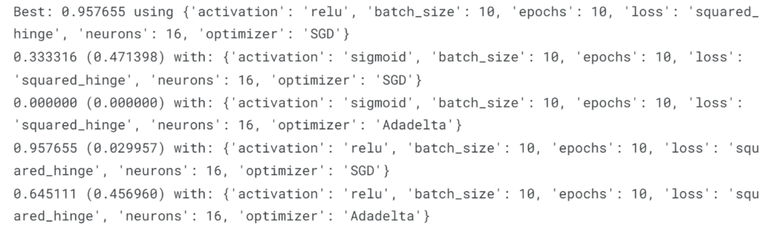
Output:

Slide 23
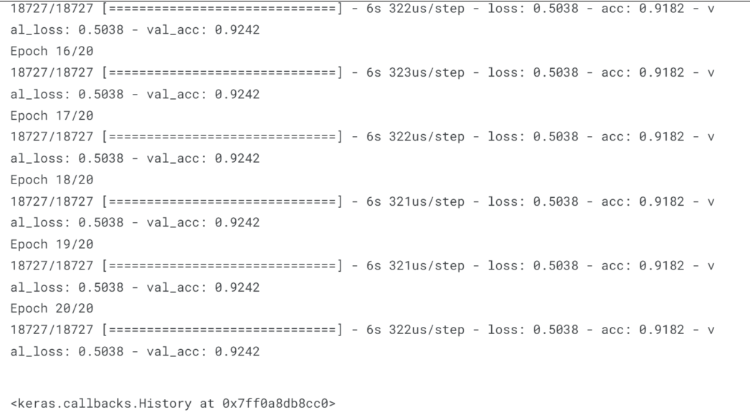
model = Sequential()
model.add(Dense(16, activation='relu', input_shape=(3,)))
model.add(Dense(16, activation='relu'))
model.add(Dense(2, activation='softmax'))
model.compile(optimizer='SGD', loss='squared_hinge', metrics=['accuracy'])
model.fit(X_train, y_train, batch_size=10, epochs=20, verbose=1, validation_data=(X_test, y_test))
Output:

Slide 24
[test_loss, test_acc] = model.evaluate(X_test, y_test)
print("Evaluation result on Test Data : Loss = {}, accuracy = {}".format(test_loss, test_acc))
Output:
Isn't it amazing that we got an accuracy of 92%.
We can say the neural network is one of the best models to predict earthquakes that can be used in future.

Slide 25
Conclusion
Understanding earthquakes and effectively responding to them remains a complex and challenging task, even with the latest technological advancements. However, leveraging the capabilities of machine learning can greatly enhance our comprehension of seismic events. By employing machine learning techniques to analyze seismic data, we can uncover valuable insights and patterns that contribute to a deeper understanding of earthquakes. These insights can subsequently inform more effective strategies for mitigating risks and responding to seismic events.

Slide 26
THANK YOU

